Slide 1
Biomedical Signal Processing with Hilbert Transform
CHAITHANYA N (22PD09)
SUJAN S (22PD35)

Slide 2

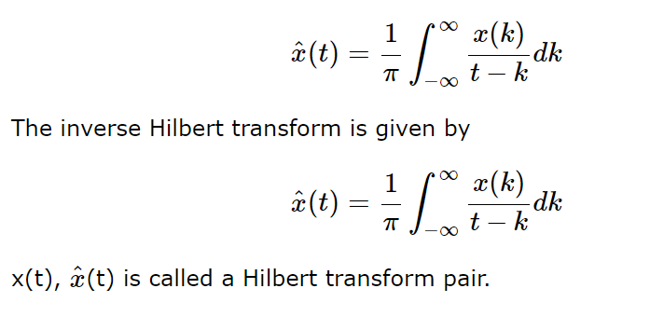
HILBERT TRANSFORM
Hilbert transform of a signal x(t) is defined as the transform in which phase angle of all components of the signal is shifted by ±90°.
Hilbert transform of x(t) is represented with , and it is given by

Slide 3
WORKING MECHANISM
The Hilbert transform is a mathematical operation applied to a signal, typically in the time domain, to obtain its corresponding analytic signal in the frequency domain. The analytic signal provides information about both the amplitude and phase of the original signal.
Here's how the Hilbert transform works:
1. Original Signal: Let's denote the original signal as x(t) , which is typically a real-valued function of time t.
2. Frequency Domain Representation: The Hilbert transform of x(t) is calculated in the frequency domain. In the frequency domain, each frequency component of x(t) is represented by a complex number. This complex number has both magnitude (amplitude) and phase.

Slide 4
WORKING MECHANISM
3. Phase Shift: When applying the Hilbert transform, the phase angle of each frequency component of x(t) is shifted by ±90° or ±π/2 radians. This means that for every frequency component in the original signal, the corresponding phase angle is either advanced or delayed by a quarter of a cycle.
4.Complex Signal: After applying the Hilbert transform, we obtain a complex-valued function in the frequency domain, denoted as H(x(t)) . This complex function represents the analytic signal associated with the original real-valued signal x(t) .
5.Analytic Signal: The analytic signal H(x(t)) can be transformed back to the time domain if desired, providing information about the amplitude and phase of the original signal. The absolute value of this complex signal gives the instantaneous amplitude of the original signal, while the argument (or phase angle) gives the instantaneous phase.

Slide 5
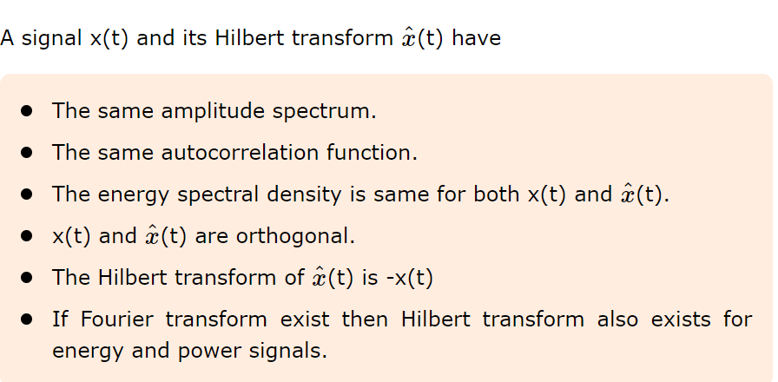
PROPERTIES

Slide 6
HOW HILBERT TRANSFORM IS APPLIED IN THE MAIN PROJECT
1. Original Signal: Let's denote the original real-valued signal as x(t) , where t represents time (or space).
2. Fourier Transform: The first step in performing the Hilbert transform involves transforming the original signal from the time domain to the frequency domain using the Fourier transform. The Fourier transform of x(t) is denoted as X(f) , where f represents frequency.
3. Frequency Response: In the frequency domain, each frequency component of the original signal x(t) is represented by a complex number X(f) . This complex number has both magnitude (amplitude) and phase.

Slide 7
HOW HILBERT TRANSFORM IS APPLIED IN THE MAIN PROJECT
4. Hilbert Filter: The next step involves applying a special filter, called the Hilbert filter or Hilbert kernel, to the frequency response X(f) . The Hilbert filter is designed such that it has a phase shift of ±90° or ±π/2 radians for all frequencies.
5. Complex Signal: After applying the Hilbert filter to X(f) , we obtain a complex-valued function in the frequency domain, denoted as H(X(f)) . This complex function represents the analytic signal associated with the original real-valued signal x(t).
6. Inverse Fourier Transform: Finally, the inverse Fourier transform is applied to H(X(f)) to obtain the analytic signal in the time domain. The resulting analytic signal, denoted as y(t) , is a complex-valued function that contains information about both the amplitude and phase of the original signal x(t) .

Slide 8
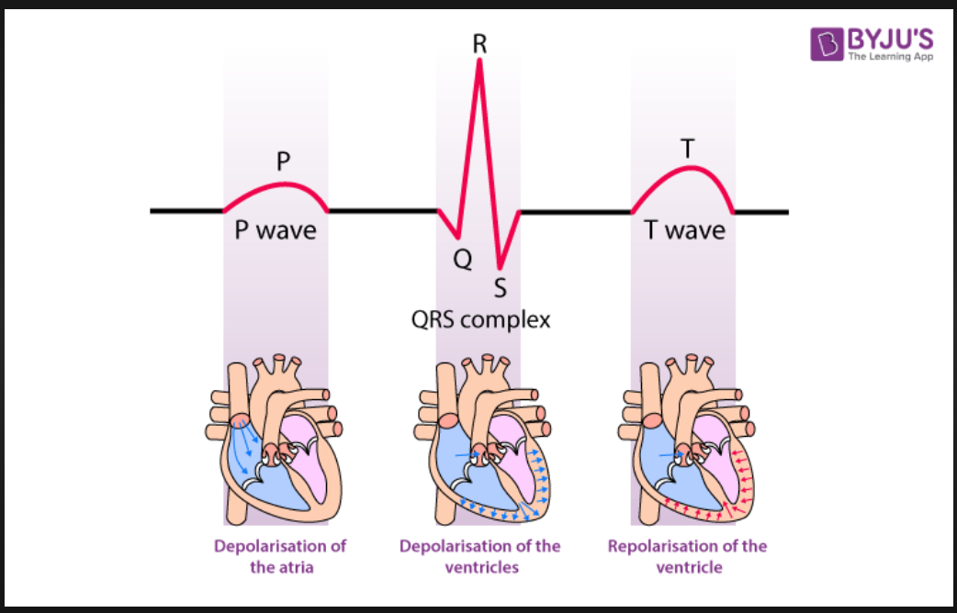
ECG
Electrocardiography is the process of producing an electrocardiogram (ECG or EKG), a recording of the heart's electrical activity through repeated cardiac cycles.

Slide 9
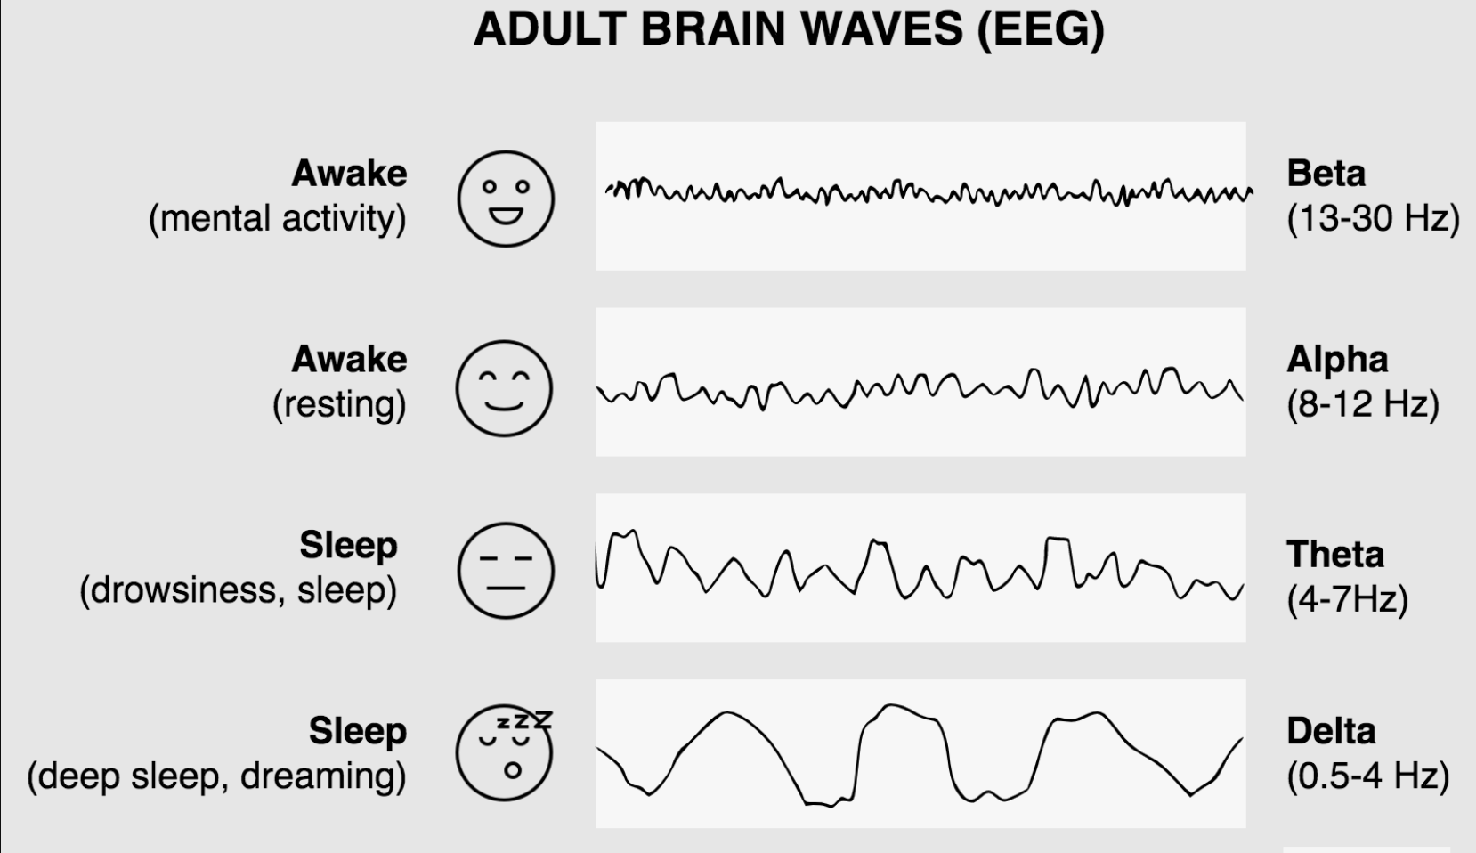
EEG
An electroencephalogram (EEG) is a test that measures electrical activity in the brain using small, metal discs (electrodes) attached to the scalp. Brain cells communicate via electrical impulses and are active all the time, even during asleep. This activity shows up as wavy lines on an EEG recording.

Slide 10
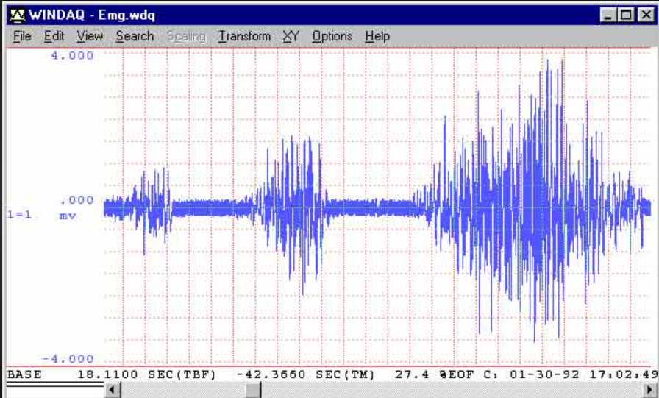
EMG
Electromyography (EMG) is a diagnostic procedure to assess the health of muscles and the nerve cells that control them (motor neurons). EMG results can reveal nerve dysfunction, muscle dysfunction or problems with nerve-to-muscle signal transmission.

Slide 11
ABSTRACT
To demonstrates various aspects of biomedical signal processing, focusing primarily on ECG (electrocardiogram), EEG (electroencephalogram), and EMG (electromyogram) signals.
1.Signal Generation and Processing:
- It generates synthetic ECG signals with noise, applies a Butterworth bandpass filter to remove noise, and then performs the Hilbert transform (though this is typically not used for ECG analysis).
- For EEG and EMG signals, it generates example signals and performs the Hilbert transform.

Slide 12
ABSTRACT
- Functions are provided for generating noisy ECG-like signals, applying bandpass filters, detecting QRS complexes (features in ECG), calculating heart rates, and extracting features from EEG and EMG signals.
2. Visualization:
- The code visualizes the generated signals, filtered signals, detected QRS complexes, and amplitude envelopes (obtained through Hilbert transformation).
- It also plots the heart rate over time for ECG signals and the amplitude envelope of EEG and EMG signals.

Slide 13
ABSTRACT
3. Classifier Training and Evaluation:
- It includes functions to train a simple classifier based on extracted features (mean, variance, max value) from EEG and EMG signals.
- The trained classifier is then evaluated for its accuracy in predicting labels (e.g., normal or abnormal).
4. User Interaction:
- It uses Tkinter to prompt the user for input parameters such as signal duration, sampling frequency, frequencies of signal components, and noise amplitude.

Slide 14
ABSTRACT
5. Main Execution:
- The main execution section collects user input for ECG, EEG, and EMG signals using Tkinter dialogs and then generates and plots the corresponding signals based on the provided parameters.
Overall, it serves as a comprehensive demonstration of processing and analyzing biomedical signals, including ECG, EEG, and EMG, along with basic classification tasks. It's a useful starting point for understanding and experimenting with signal processing techniques in the biomedical domain.

Slide 15
INPUT
ECG SIGNAL
Duration of the ECG Signal(in seconds): 10
Sampling frequency (in Hz): 1000
Frequency of P wave (in Hz): 1
Frequency of QRS complex(in Hz): 5
Frequency of T wave(in Hz): 0.5
Amplitude of Gaussian noise: 0.5

Slide 16
INPUT
EEG SIGNAL
Duration of the EEG signal(in seconds): 20
Sampling frequency(in Hz): 200
EMG SIGNAL
Duration of the EEG signal(in seconds): 15
Sampling frequency(in Hz): 500

Slide 17
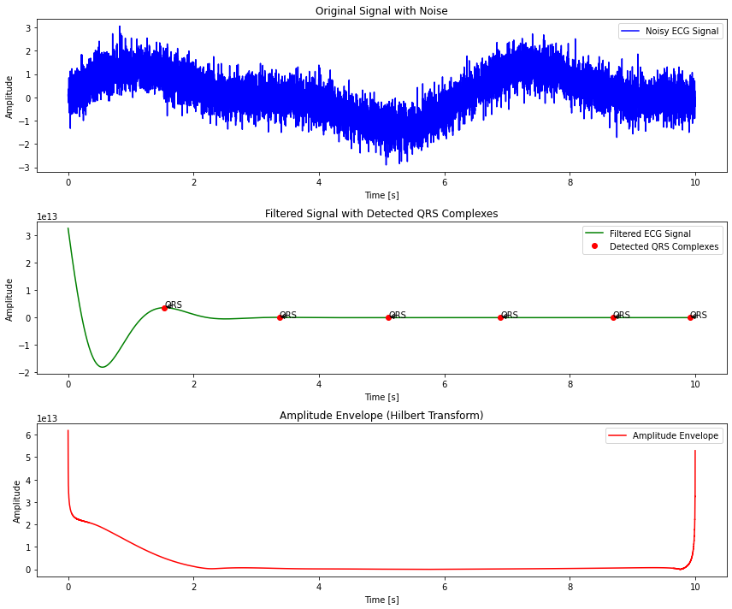
OUTPUT : ECG

Slide 18
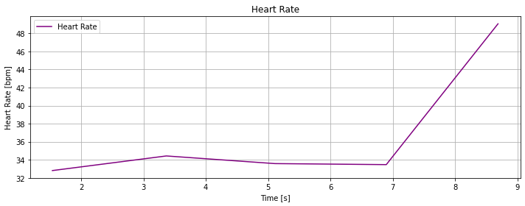
HEART RATE

Slide 19
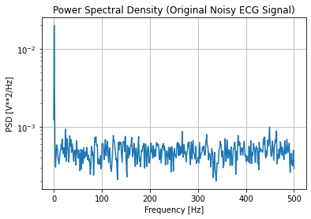
POWER SPECTRAL DENSITY

Slide 20
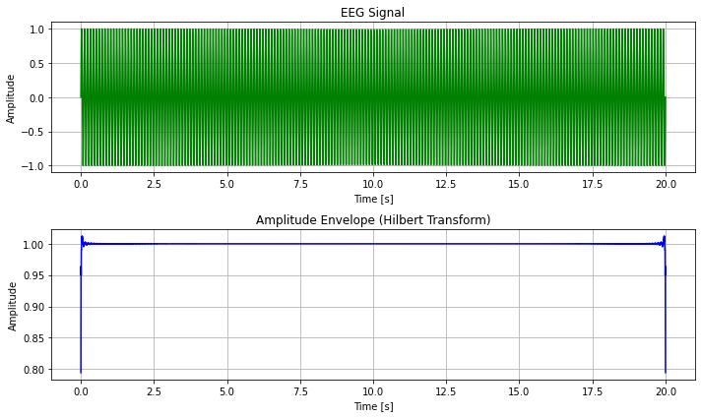
OUTPUT : EEG

Slide 22
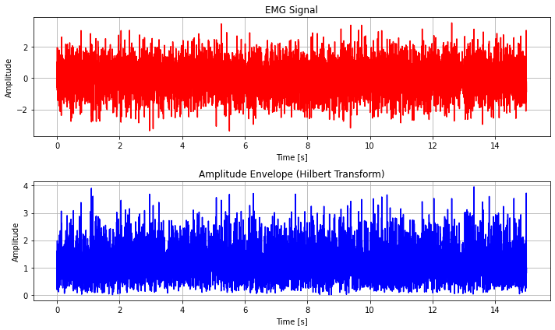
OUTPUT : EMG

Slide 23
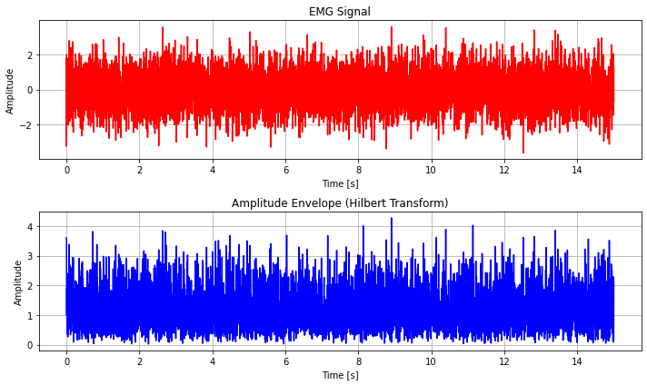

Slide 24
THANK YOU

